Slide 1
Thinking about Graphs
The Grammar of Graphics and Stata

Slide 2
Reconstructing two examples
From American Sociological Review, August 2005
in Kara Joyner and Grace Kao’s “Interracial Relationships and the Transition to Adulthood ”
in Michael J. Rosenfeld and Byung-Soo Kim’s “The Independence of Young Adults and the Rise of Interracial and Same-Sex Unions ”

Slide 3
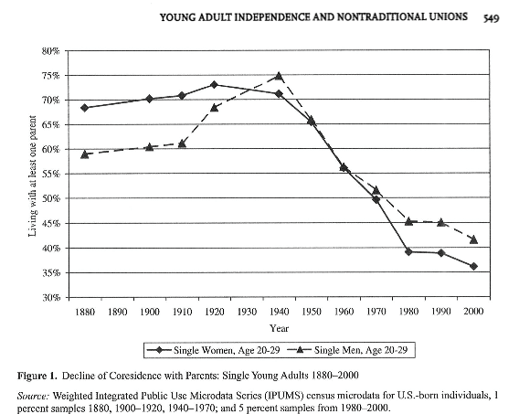
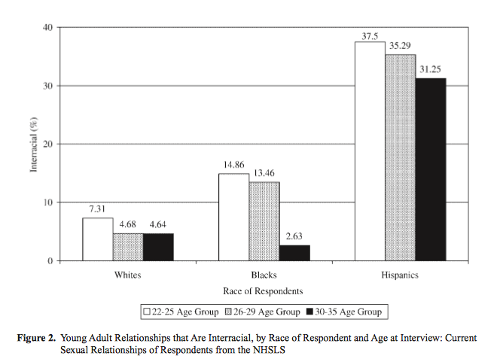
Examples for reconstruction

Slide 4
Questions toward reconstruction
What are the graphical elements? (Geometric objects)
How are they related to data? (Variables)
How are they arranged on the screen/paper? (Coordinates and guides)
How are they decorated? (Style and aesthetics)
Notes:
Graphical elements: points, lines, shaded areas.
Relation: given in the data, or derived?
Screen layout: coordinates, scales.
Decoration: color, weight, pattern, annotation, etc.

Slide 5
Graphical elements/Geometric objects
Rectangular boxes, “bars”
Notes:
Most (all?) statistical software lets us treat bars as a graphical element.

Slide 6
Graphical elements/Geometric objects
Points and lines/line segments

Slide 7
Stata’s fundamental graphical elements
help graph
help graph twoway
graph twoway → → → →
graph matrix
graph bar
graph dot
graph box
graph pie
scatter
line/connected
area
bar
spike/dropline
dot
contour
plus a few more
Notes:
Open Stata and use Help!

Slide 8
Relation to data
The height of each bar is a summary statistic.
The horizontal position of each bar is given by a combination of two categorical variables.

Slide 9
Sufficient data
The minimum data we need is three variables – two categorical variables and a summary variable.
race agegroup inter
1 1 7.31
1 2 4.68
1 3 4.64
2 1 14.86
2 2 13.46
2 3 2.63
3 1 37.5
3 2 35.29
3 3 31.25

Slide 10
Simple graph bar
use "JoynerKao2005.dta", clear
graph bar inter
graph bar inter, over(agegroup)
graph bar inter, over(agegroup) over(race)
Notes:
With the first command, notice that “inter” is the variable that locates the top of the bar on the y-axis. Also notice that it is calculating a summary statistic, a mean, by default.
In the second command, we break this out by groups: the x-axis is a categorical axis. “Inter” is still being summarized on the y-axis as a mean, and the y-axis is continuous.
In the third command we have a doubly categorical x-axis, and we have arrived at the geometry we are after.
Beyond this is a slew of small adjustments.

Slide 11
Cleanup – no summary
graph bar (asis) inter, over(agegroup) ///
over(race)
See help graph_bar for a list of summary statistics you could use other than mean and asis
Notes:
If you don’t use a summary statistic your categories must uniquely identify each observation/row in the data set.

Slide 12
Cleanup – no gap, add legend
graph bar (asis) inter, over(agegroup) ///
over(race) asyvars
“asyvars” is cryptic. To see multiple “y” variables with no grouping, try
graph bar inter race agegroup
The idea here is that the groups in the first over() are displayed like multiple y variables.

Slide 13
Guides – axes and legends
Axes and legends help us keep track of the meaning of different graphical elements, so they also are connected to our data
Variable labels
Value labels
See also
help graph_bar##axis_options
help graph_bar##legending_options

Slide 14
Variable labels
label variable inter "Interracial (%)"
label variable race "Race of Respondents"
label variable agegroup "Age Group"
graph bar (asis) inter, over(agegroup) ///
over(race) asyvars

Slide 15
Value labels
label define racelbl 1 "Whites" 2 "Blacks" ///
3 "Hispanics"
label values race racelbl
label define agelbl 1 "22-25 Age Group" 2 ///
"26-29 Age Group" 3 "30-35 Age Group"
label values agegroup agelbl
graph bar (asis) inter, over(agegroup) ///
over(race) asyvars

Slide 16
Bar labels
graph bar (asis) inter, over(agegroup) ///
over(race) asyvars blabel(bar)

Slide 17
Annotation and Aesthetics
Titles, captions, and footnotes
Color, weight, etc. of graphical elements
Grid or guidelines
Etc. – there tend to be a large number of options at this point
These attributes all have default values. A collection of default values is a “scheme” in Stata (or “style”).

Slide 18
Black and white scheme
graph bar (asis) inter, over(agegroup) ///
over(race) asyvars blabel(bar) ///
scheme(s1mono)

Slide 19
Individual bar colors
graph bar (asis) inter, over(agegroup) ///
over(race) asyvars blabel(bar) ///
scheme(s1mono) bar(1, ///
fcolor(gs16)) bar(2, ///
fcolor(gs12)) bar(3, fcolor(black))

Slide 20
Titles, captions, notes
graph bar (asis) inter, over(agegroup) over(race) asyvars /// blabel(bar) scheme(s1mono) bar(1, fcolor(gs16)) /// bar(2, fcolor(gs12)) bar(3, fcolor(black)) /// caption("Figure 2. Young Adult Relationships that Are Interracial", ring(5)) ///
note("NHSLS = National Health and Social Life Survey", ring(6)))

Slide 21
Beginning from individual data
We have been graphing a summary statistic
The issue is whether or not our graph command can summarize as we want

Slide 22
Set up the data
use "nhsls.dta", clear
keep if sample == 2
gen wgt=hhsize*(3159/6008)
keep if age <=35
keep if ethnic <= 4
forvalues i=1/4 {
generate prace`i' = sprace`i' if sp2ply`i' < 3
}
keep caseid age prace1-prace4 race ethnic wgt
recode prace* (7/9 = .)
recode age (18/21=1) (22/25=2)(26/29=3)(30/35=4), generate(agegroup)
reshape long prace, i(caseid) j(partner)
keep if prace~=.
generate inter = ethnic ~= prace

Slide 23
A second look at graph bar
graph bar inter // mean
graph bar (percent) inter
* not what you expect!
graph bar (percent), over(inter)
tab inter

Slide 24
Add another categorical variable
graph bar (percent), over(inter) over(agegroup) ///
blabel(bar)
tab inter agegroup, col cell

Slide 25
Problems
Percents are percent of total rather than percent of category
Bars for the unwanted category
Solutions
Work in fractions rather than percents
Create a summary data set

Slide 26
As fractions
graph bar inter, over(agegroup) over(race) ///
blabel(bar)

Slide 27
With our other options applied
Variable labels
Value labels
Scheme
Bar color
Axis label angle
Caption
Note
One new option is the “ytitle”

