Slide 1
Bayesian Persuasion
L8
Kamienica and Genzkow (AER 2011)

Slide 2
Bayesian Persuasion Framework
Two agents: Sender (S) and Receiver (R)
Type space Action space . Message space
Preferences
S sends message, , R responds with an action
S ex ante commits to
Solution concept
Important tool

Slide 3
KG Prosecutor/Judge example
Story: prosecutor S and judge R
Binary model
Preferences
For beliefs R optimal choice
Expected S utility given common beliefs (no persuasion)

Slide 4
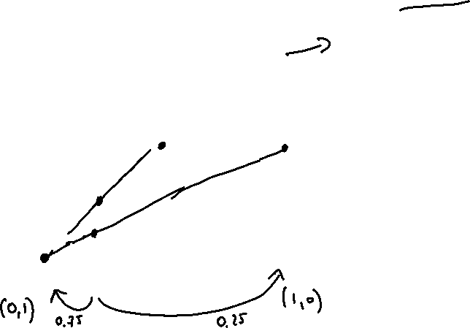
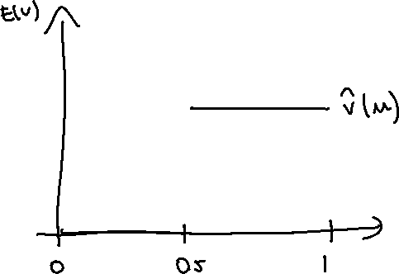
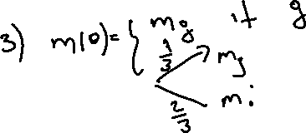
KG example
Prior
3 information structures
Is this information structure optimal?

Slide 5
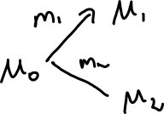
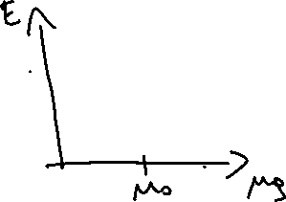
Set of Bayes plausible (distributions of) posteriors
Aumann and Mashler (1995)
Messages split prior into ``random’’ posteriors
induces random posterior
is Bayes plausible given if induced by some
set of all Bayes plausible posteriors
P: if and only if
Heuristic proof
Equivalent optimization problem

Slide 6
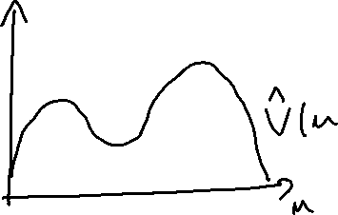
Concavification of value function
Value function of the persuasion program
P: Value function coincides with concave closure of . on
Implication: is concave

Slide 7
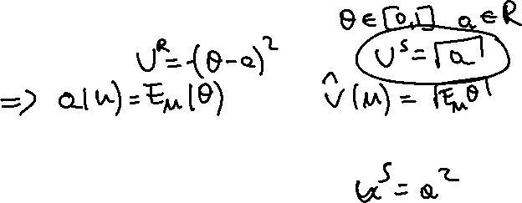
Observations:
Given prior , S has incentives to transmit information whenever
Concave for all beliefs
No transmission of information
Example:
Convex only at the degenerate beliefs
Full transition of information
Examples:
KG Prosecutor/Judge example?

Slide 8
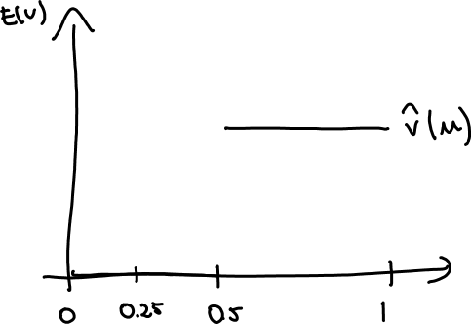
KG example: function is neither concave nor convex
How about
Optimal transmission of information?

Slide 9
Characterization results
Condition for incentives to transmit information
Necessary: existence of beliefs that S would share
Sufficient: Necessary + discreteness

Slide 10
Incentives to transmit information (necessity)
Fix prior and let
D: S would share beliefs with R if
Example:
Remark: verification of the condition requires graph of

Slide 11
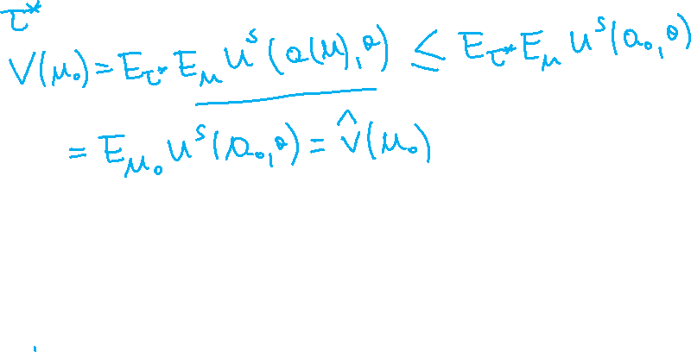
Necessary condition
P: S has incentives to transmit information only if exist that S would share
Proof:

Slide 12
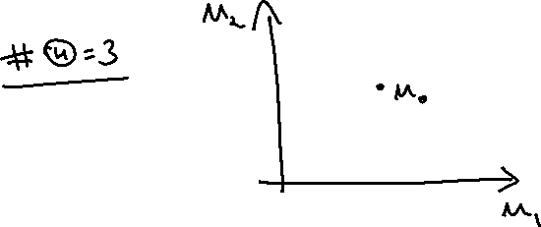
Transmission of information (sufficiency)
D: R preferences are discrete at if
Remarks:
preferences are discrete, generically
and continuous no
is optimal for posterior in the neighborhood of

Slide 13
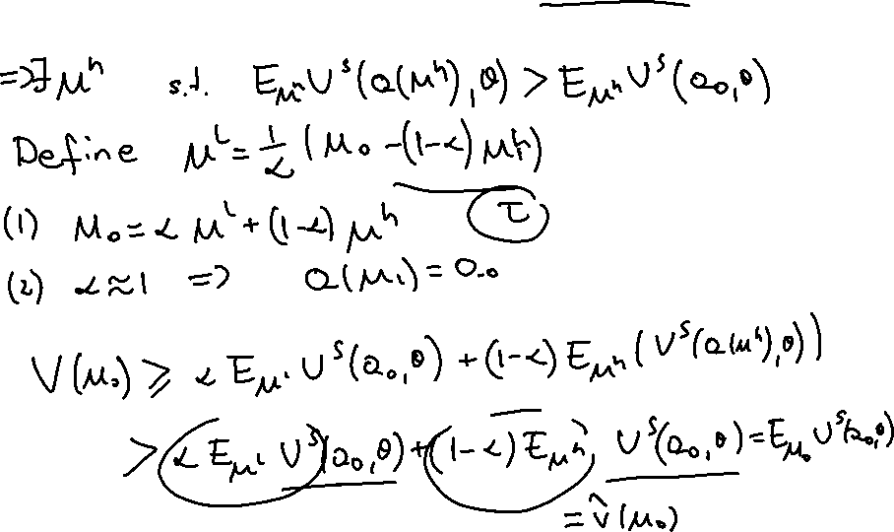
Transmission of information (sufficiency)
P: Suppose at R preferences are discrete and there is that S would share. Then S benefits from transmission of information

Slide 14
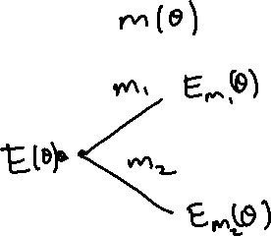
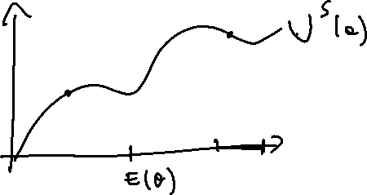
Expected state model
hard to work with when
Consider
Note
Can concave of . closure be used to make predictions?

Slide 15
Summary
Value function in the persuasion problem is concave
A geometric tool to find optimal message strategy in 2 state example
Some results characterizing persuasion
Not clear if they this help to find optimal mechanism in a general model
Limitations:
settings with more than two states?
Settings with two or more agents?
Solutions:
2-stage approach

