Slide 1
The Institute for Research on Poverty (IRP):
Reducing Poverty via Researcher, Practitioner and Community Partnerships
Hilary Shager, PhD
IRP Associate Director of Programs & Management
The Wisconsin Idea, Past & Present Public Lecture Series
October 16, 2018

Slide 2
Overview
What (and who) is the Institute for Research on Poverty (IRP)?
The Wisconsin Idea at IRP
  Some history
  IRP as the National Poverty Center
  Work with WI State Agencies
  DreamUp Wisconsin
Helping IRP realize the WI Idea

Slide 3
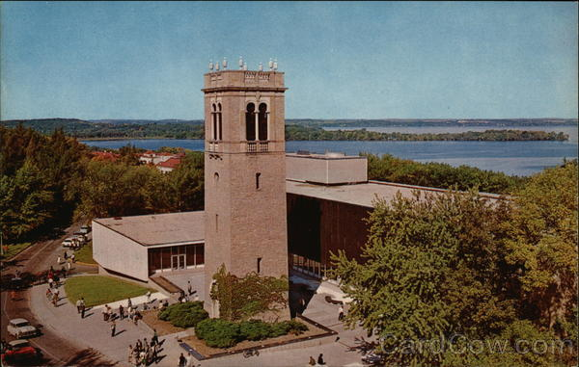

What Is
The Institute for Research on Poverty?
Established in 1966 during the War on Poverty
Functions as an independent, multi-disciplinary center within the College of Letters & Science at the UW-Madison
Core infrastructure funding from the UW-Madison and U.S. Dept. of Health & Human Services
> $20 million in research project funding from grants and contracts from foundations, state and federal agencies

Slide 4
Realizing the “Wisconsin Idea”
Mission
  The Institute for Research on Poverty (IRP) advances the understanding of the causes and consequences of poverty and inequality by producing rigorous research, training scholars, engaging with policymakers and practitioners, and widely disseminating evidence.
Vision
  Policies and practice are informed by evidence and lead to the reduction of poverty and inequality in the United States.

Slide 5
How Do We Accomplish Our Mission?
Explicitly connect research, training, policy, practice
Leverage multi-disciplinary, multi-method knowledge, skills, and ongoing activities of:
  25 staff
  200 affiliates
  8 institutional members of the U.S. Collaborative Poverty Centers
Oversee >$20 million in research grant funding annually
Develop and maintain ongoing, collaborative relationships with policymakers and practitioners
Train and support a diverse, multi-disciplinary corps of poverty researchers with opportunities for undergraduates through junior faculty

Slide 6
What is Our “Logic of Collaboration”?
Collaboration Supports Policy Development and Academic Research
IRP
University of Wisconsin-Madison
University resources
Technical expertise
Long time horizon
Funding
Local, State, Federal Agencies & Other Partners
Policy issues
Innovative programs
Real-world experience
Data
Funding
Notes:
6

Slide 7
Select Research Questions
Who are the poor and what are their characteristics?
How do we measure poverty?
How do safety net programs interact with labor market involvement?
How does family structure affect poverty?
Do job training efforts work to reduce poverty?
What are the factors driving persistent income differences among minority groups such as African Americans, Hispanics, Native Americans, or immigrants?
How should child support systems function?
What are the connections between income and health?

Slide 8
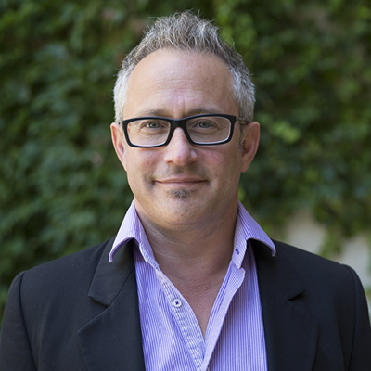
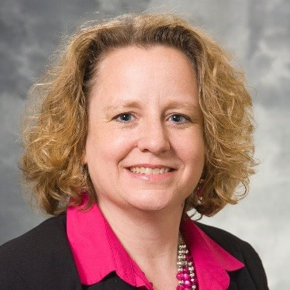
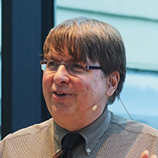
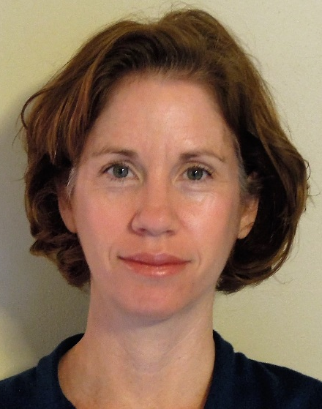
Who We Are: Current Leadership
Lawrence (Lonnie) Berger
Director,
Vilas Distinguished Achievement Professor of Social Work
Hilary
Shager
Associate Director Programs and Management, Researcher
Jeffrey Smith Associate Director Research & Training, Paul T. Heyne Distinguished Chair in Economics and Richard A Meese Chair in Applied Econometrics
Rebecca (Becca) Schwei
Policy & Research Coordinator,
Researcher

Slide 9
Who We Are: Executive Committee
Lawrence Berger (Chair), IRP Director, Social Work | Jason Fletcher, Public Affairs, Sociology, Center for Demography of Health and Aging (Director)
Hilary Shager, IRP Associate Director for Programs and Management, Researcher | Sarah Halpern-Meekin, Human Development and Family Studies
Jeff Smith, IRP Associate Director for Research and Training, Economics | Robert Haveman, Economics, Public Affairs
Judith Bartfeld, Consumer Science | Katherine Magnuson, Social Work
Tonya Brito, Law | Michael Massoglia, Sociology
Maria Cancian, Public Affairs, Social Work | Daniel Meyer, Social Work
Marcia Carlson, Sociology, Center for Demography and Human Ecology (Director) | James Raymo, Sociology
Jane Collins, Community and Environmental Sociology, Women’s Studies | Timothy Smeeding, Public Affairs, Economics
J. Michael Collins, Consumer Science, Public Affairs, Center for Financial Security (Director) | Christopher Taber, Economics
Marah Curtis, Social Work | Barbara Wolfe, Economics, Public Affairs, Population Health Sciences

Slide 10
IRP Organizational Chart

Slide 11
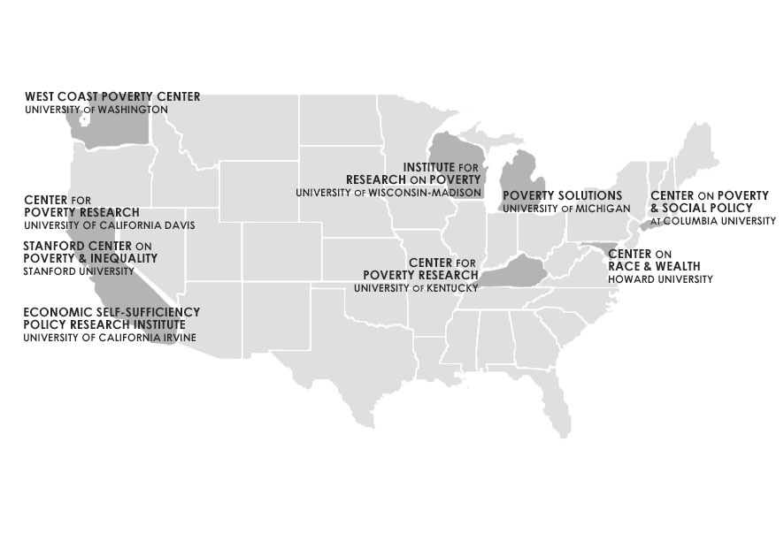

Select ASPE-Supported Research Activities:
U.S. Collaborative of (9) Poverty Centers
IRP is hub
Leverages partners’ joint resources to facilitate a sustainable, nationwide infrastructure of poverty researchers studying a diverse range of policy-relevant issues

Slide 12
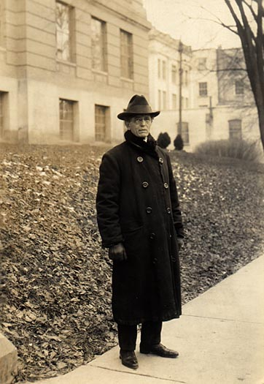
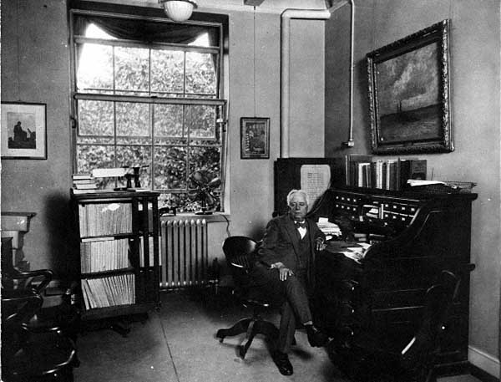
IRP and the Wisconsin Idea:
Some History-1st Generation
The Wisconsin School
  Richard Ely, John Commons
  New field of social science research
  Worker’s compensation
  Unemployment compensation
  State income tax
http://digicoll.library.wisc.edu/WIReader/Images/WER1577.html; http://digicoll.library.wisc.edu/WIReader/Images/WER0506.html

Slide 13
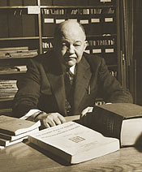
IRP and the Wisconsin Idea:
Some History-2nd Generation
Responses to the Great Depression
  Edwin Witte
  FDR’s Committee on Economic Security
  Social Security Act (1935)
  National Labor Relations Act
https://news.wisc.edu/social-security-at-75-rooted-in-the-wisconsin-idea/

Slide 14
IRP and the Wisconsin Idea:
Some History-3rd Generation
The War on Poverty
  Robert Lampman
  Council of Economic Advisors (Kennedy, Johnson)
  Independent research center to demonstrate impact of new programs and policies
  Concern that analysis of gov’t programs would take away from more “serious” academic work

Slide 15
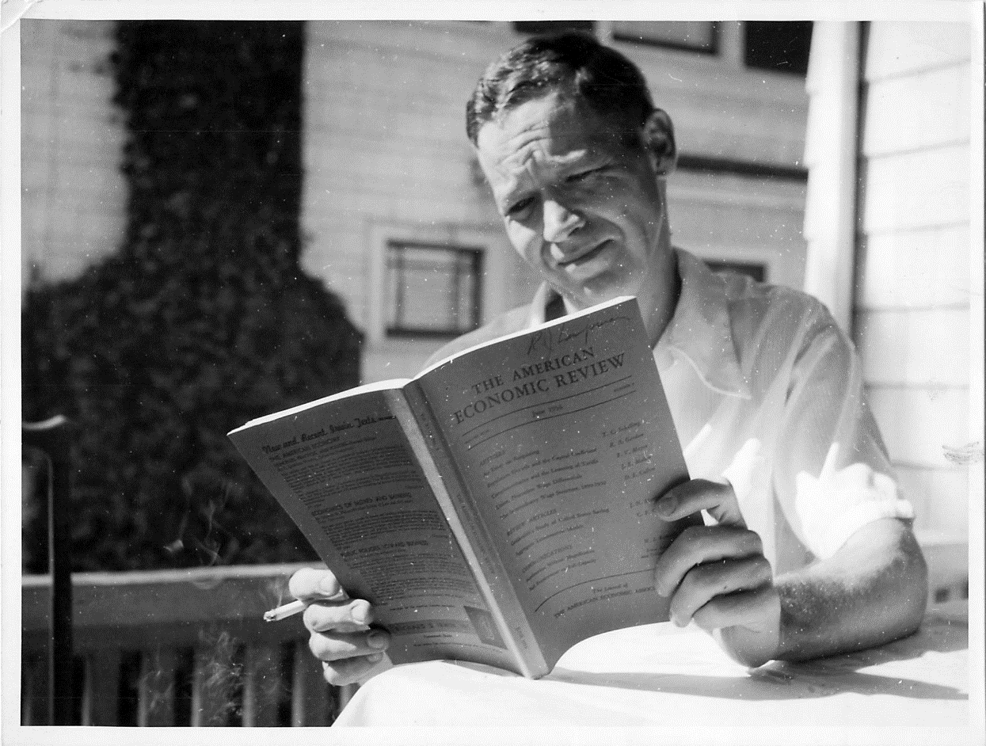
Core National Poverty Center Mission:
Serve as Both Catalyst and Hub
“Certainly one of the justifications for a large-scale grant to a single institution as opposed to a whole set of small project grants scattered all over the place, is that you reach a critical mass of research interest when you get a group of people together who have similar interests, but different backgrounds. We hope that there will be more than merely individual contributions which accumulate; we hope there will be a multiplying process or a chemical interaction between and among the various researchers.”
—Robert Lampman,
Conference on Poverty Research, Communications, and the Public, April 1966

Slide 16
National Poverty Research Center
Cooperative Agreement
IRP is the only federally funded poverty center in the US
  Implementing a 5-year (2016-2021) cooperative agreement with the Office of the Assistant Secretary for Planning and Evaluation (ASPE) in the U.S. Department of Health and Human Services (HHS)
Overall goal:
  Increase the effectiveness of public policies by building the evidence base on the causes of poverty and inequality and the impact of related policies and programs
Three required areas of activities:
  Research
  Training and mentoring
  Dissemination

Slide 17
ASPE-Supported Research Activities
Cross-Theme Research Activities Annual Poverty Research and Policy Forum Quarterly Poverty Policy-Research Memoranda to ASPE Leadership Quarterly IRP-ASPE Learning Exchanges and “Pop-Up Panels” Rapid-Response Technical Assistance Memoranda Short-Term In-Residence Program at ASPE Extramural and Intramural Small Research Grant Competitions Dissertation Fellowships | Scholar-in-Residence Program for Underrepresented Groups Dissertation Proposal Workshop for Underrepresented Graduate Students U.S. Collaborative of Poverty Centers Other Research Activities IRP Summer Research Workshop IRP UW–Madison Seminar Series Summative Antipoverty Policy Volumes Ongoing Research Grants Administration and Support

Slide 18
Complementary Research Activities
Child Support Non-custodial Parent Employment Demonstration (CSPED)
  8-state randomized study of programs to improve non-custodial parent employment and earnings, child support payment, and involvement with children
Baby’s First Years
  Randomized study that that will explore whether income level actually has a causative effect on brain development
Researcher-Practitioner Partnerships for Timely Program Evaluations Using Existing Data
  Re-grant program funded by The JPB Foundation
    “Does the Labor Market Give Credit for Learning Online?”
    “Leveraging Administrative Data to Increase Take-Up of SNAP and EITC”

Slide 19
Thematic Research Networks
Designed as intellectual “hubs” of IRP’s work
Informs nearly all major IRP activities
Current networks:
  Poverty and geography
  Poverty and family functioning
  Poverty, employment, and self-sufficiency
  Poverty and the transition to adulthood
  Poverty and tax policy

Slide 20
The Russell Sage Foundation
Journal of the Social Sciences
Anti-poverty Policy Innovations for the United States
Vol. 4, No. 2 & 3, Feb. 2018 (https://www.rsfjournal.org/loi/rsf)
Editors: Lawrence M. Berger, Maria Cancian, Katherine Magnuson
Universal child allowance
Cash for kids (universal child benefit)
Minimum benefit plan for elderly
Single-parent family policy reforms
Reconstructing Supplemental Nutrition Assistance Program (SNAP)
Renter’s tax credit
“Rainy Day” component of Earned Income Tax Credit (EITC)
Minimum wage & “making work pay” via the tax system
Federal job guarantee
National subsidized employment
“Race to the Top” in public higher education
Postsecondary pathways out of poverty
Two-generation human capital (Head Start + community colleges)
Long-acting reversible contraceptives

Slide 21
ASPE-Supported Dissemination Activities
Internal Memoranda Quarterly Poverty Policy-Research Memoranda to ASPE Leadership Rapid Response Technical Assistance Memoranda Convenings Quarterly IRP-ASPE Learning Exchanges Thematic Research Workshops Annual Poverty Research and Policy Forum Research Network Meetings Topical Events Seminars and Lectures IRP UW-Seminar Series New Perspectives in Social Policy Robert Lampman Memorial Lecture | Publications Focus and Focus+ Fast Focus Research/Policy Brief Poverty Fact Sheets Electronic Media Podcasts and Webinars Electronic Communications Dissemination Website Twitter, Facebook, YouTube Electronic Mailing Lists Public Information Personalized Response

Slide 22
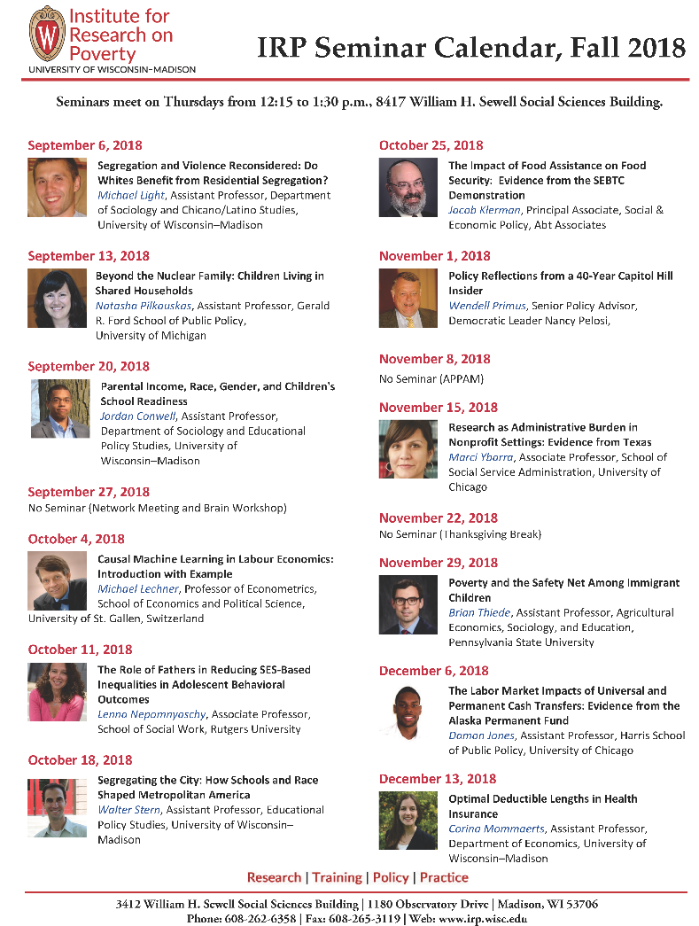
https://www.irp.wisc.edu/events/
Weekly Seminars:
Thursdays
12:15-1:30pm
8417 Social Sciences
1180 Observatory Dr.
Also see:
Lampman Lecture
New Perspectives

Slide 23
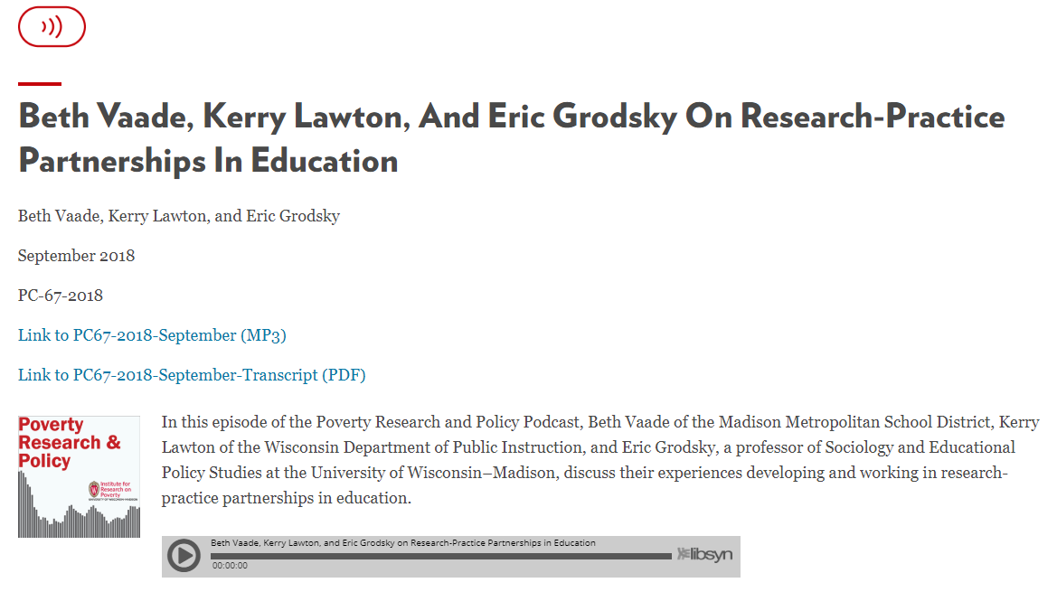
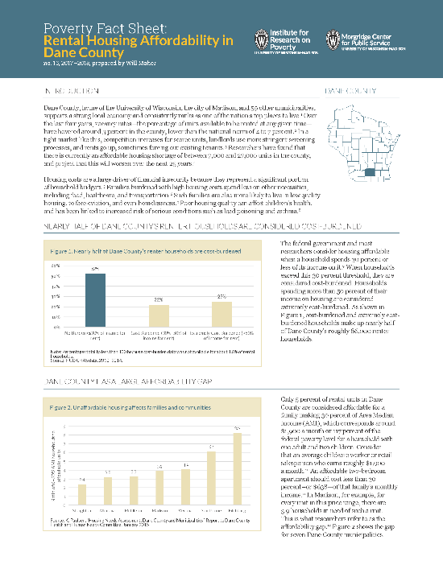
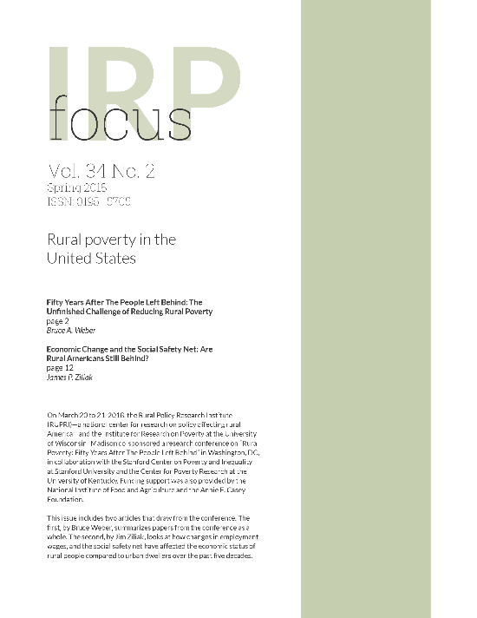
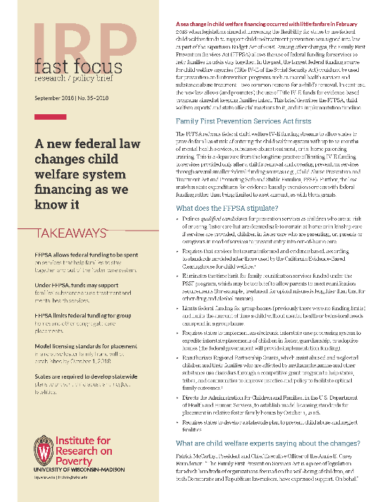

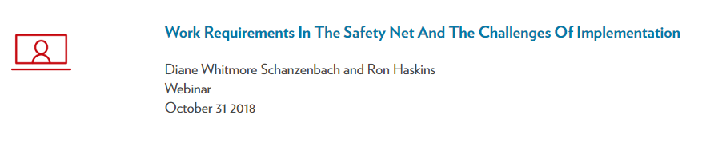
Other Dissemination Activities
Who Is Poor In Wisconsin?
https://www.irp.wisc.edu/resources/

Slide 24
ASPE-Supported Training Activities
Train and support a diverse corps of poverty researchers
Undergraduate Students Poverty and Policy Careers activities Media and Publications Multidisciplinary Courses Morgridge Center for Public Service Internship Program Graduate Students Graduate Research Fellows Program Dissertation Fellowships Research Assistantships Multidisciplinary Seminars Dissertation Proposal Workshop for Underrepresented Graduate Students Participation in IRP Activities | Promising Scholars National Poverty Fellows Program Scholar-in-Residence Programs IRP Summer Research Workshop Faculty Extramural and Intramural Small Research Grant Competitions Mentoring Technical Assistance and Workshops Teaching Poverty 101 Workshop

Slide 25
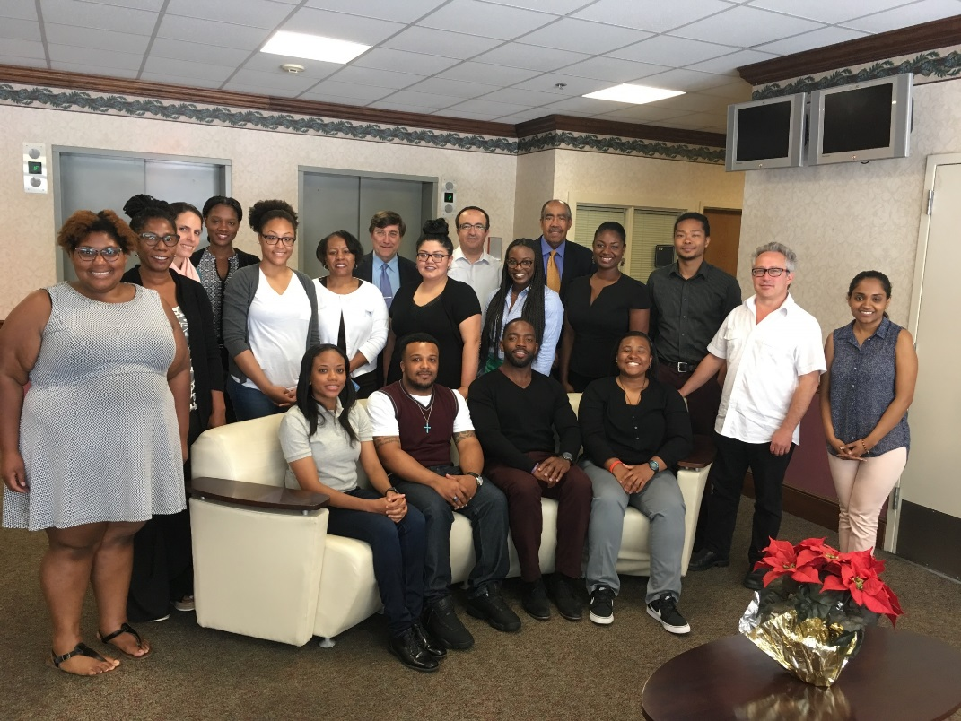
Dissertation Proposal Workshop for Underrepresented Graduate Students
May 2017 & 2018 at Howard University
Staffed by IRP and Howard University faculty

Slide 26

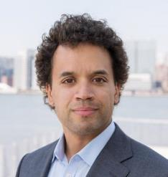
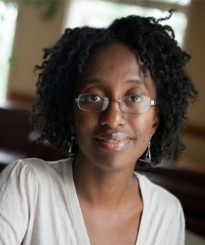
Other Training Activities
IRP/JPB Emerging Scholars Fellowships for promising junior faculty from underrepresented populations
Stephanie L. Canizales Jacob William Faber Jamila Michener
Shepherd Higher Education Consortium on Poverty (SHECP)
  Collaborative summer internship integrated with course-work and community engagement opportunities during the academic year

Slide 27
Work with WI State Agencies
“Yours, Mine & Ours”
  Setting a shared research agenda
  Technical assistance and research contracts
  Partnerships in seeking federal grants
  Learning exchanges & brown bags
  Outreach to local and state government officials
  Linking administrative data

Slide 28
Examples from Child Support
Child Support Demonstration Evaluation, pass-through policy
Families Forward
Interaction between child support and child welfare
Child Support Noncustodial Parent Employment Demonstration (CSPED)

Slide 29
Data Integration: Multi-Sample Person File Current Model
Child Welfare
DOC:
State Incarceration
CARES:
TANF, SNAP
Child Care
Medicaid
KIDS:
Child Support orders
CS payments
CS receipts
Paternity Establishment
Divorce
Not shown:
CRN: AFDC/Foodstamps
UI benefits
Milwaukee Jail
School Data
UI wage record
29

Slide 30
Current Wisconsin State
Administrative Data Resources
CORE – fully linked:
SNAP/Food Stamps (CRN, CARES)
Child Protective Services (WiSACWIS)
AFDC/TANF (CRN, CARES)
Medicaid/Badgercare (CRN, CARES)
Child Care Subsidy (CARES)
Child Support (KIDS)
Unemployment Insurance Benefits (UI)
Incarceration (Dept. of Corrections)
Milwaukee Jail
REGULAR MATCH:
Wage Records (UI)
SPECIALIZED MATCH (ad hoc/samples):
Department of Public Instruction (K-12)
Medicaid/Badgercare Claims (CRN, CARES)
Department of Revenue
Juvenile Circuit Court Records
SSI records (CARES)
Vital Records (births/paternity)
Circuit Court Records (CCAP; foreclosures)
Family Court Records (not electronic)
TANF Applicants (not electronic)
Parent Surveys
CSPED

Slide 31
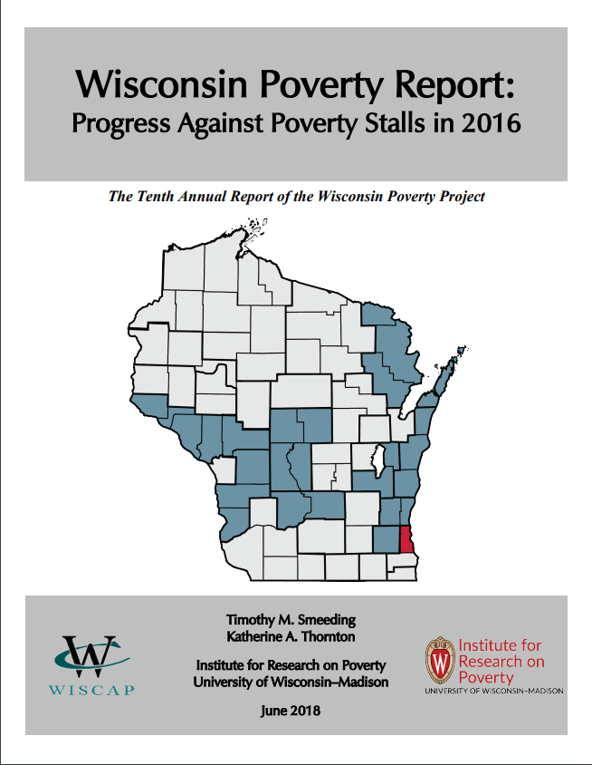
WI Poverty Report
Wisconsin Poverty Measure based on Federal Supplemental Poverty Measure, reflecting expenditures on food, clothing, shelter, and transportation adjusted for cost of living differences between WI and rest of the US and considering noncash benefits and taxes, including refundable tax credits.
Latest report found stalled progress in poverty rate reduction (10.8%), despite growing economy
Milwaukee Co. race and ethnicity supplement finds higher rates of poverty for Blacks and Hispanics
https://www.irp.wisc.edu/wp/wp-content/uploads/2018/06/WI-PovertyReport2018.pdf

Slide 32
Work as Advisors to National and Local Groups
Member, United Way of Dane County Delegation to Create Economic Stability for Young Families
Advisor to the Wisconsin Governor’s Future of the Family Commission
Member, WI Education Research Advisory Council
Consultation with the National Conference of State Legislatures, National Governors Association, American Public Human Services Association, and others
Commissioner on the Washington State Blue Ribbon Commission on the Delivery of Services to Children and Families
Member of planning committee for a National Research Council (NRC)/National Academy of Sciences (NAS) Social Mobility Workshop
Participate in forums such as a workshop of the National Academies of Sciences, Engineering, and Medicine, Standing Committee on Creating the American Opportunity Study; OPRE’s 2015 Innovative Methods Meeting; and a hearing of the Commission on Evidence-Based Policy Making

Slide 33

DreamUp Wisconsin
How can we raise the income of
10,000 middle class Dane County families by 10% by 2020?
DreamUp WI Video

Slide 34



The Alliance for the American Dream
Schmidt Futures
  “Venture facility for public benefit”
  Headed by Eric Schmidt, former CEO of Google
Unique application process
UW-Madison chosen as 1 of 4 inaugural Alliance partners
Notes:
Tell story of how the opportunity came to IRP
Talk about quick timeline

Slide 35
Strongest Solutions Will
Include a community-university partnership
Draw from and benefit a diverse set of people and communities
Be interdisciplinary or multi-sector
Be evidence-based and use technological innovation
Be responsive to Dane County community needs

Slide 36
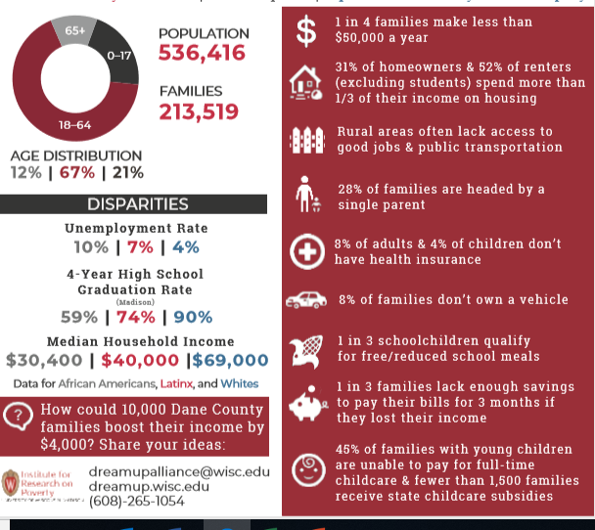

Slide 37
DreamUp WI Timeline
May-Aug
2018
Community and UW Outreach
Initial proposal development
Sep-Nov
2018
Narrow to 10+ viable proposals
Develop to full proposals ($10K)
Dec-Jan
2018-19
Narrow to top 3 proposals
Compete for further support from Schmidt (1-2 teams)
Feb-June
2019
Continue to develop 1 (or 2) ideas chosen by Schmidt
Compete for capital funding from Schmidt
Then, Round 2!

Slide 38
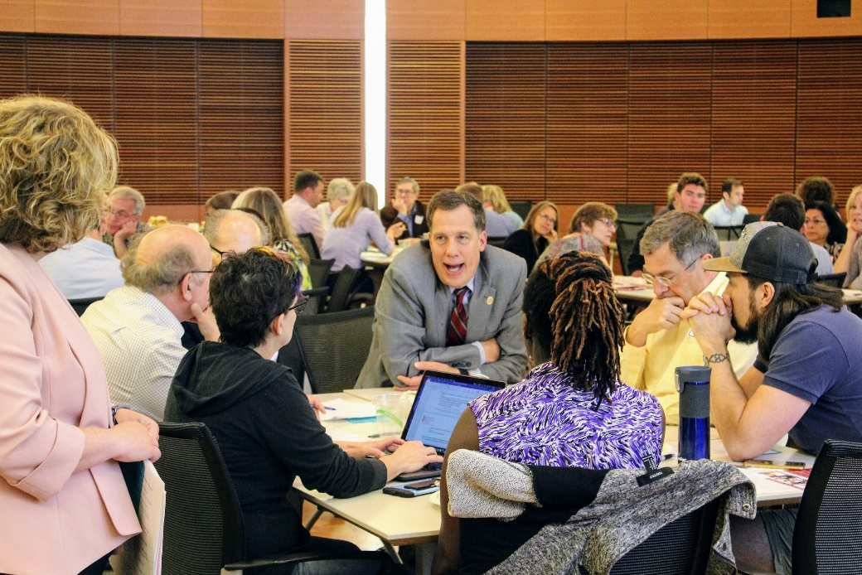
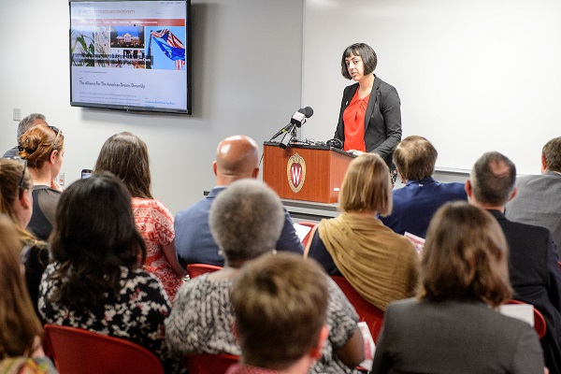
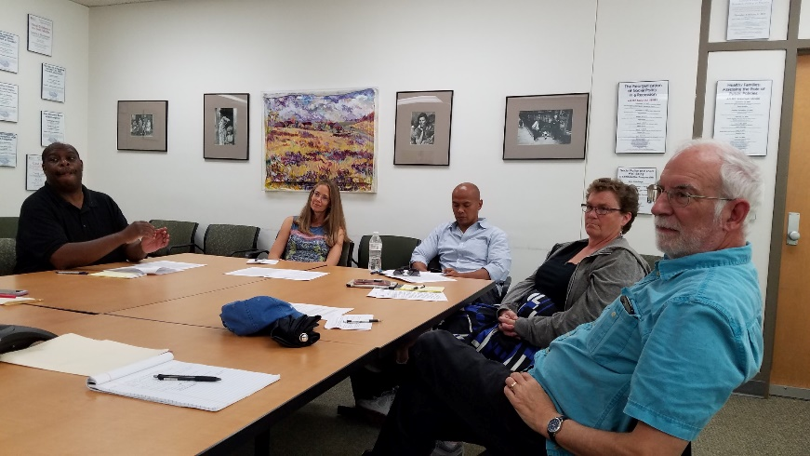
Public Outreach

Slide 39
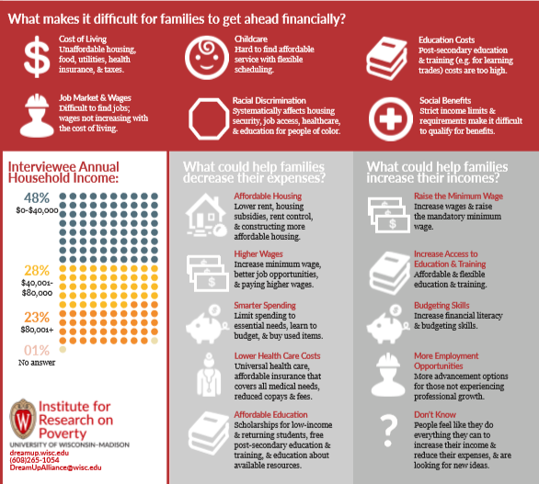

Slide 40
Congratulations to Our Semi-Finalists
Dane County SkillUp Initiative: A Path to the Middle Class through Skill Building, Degree Completion, & Credentialing
Transforming the Early Childhood and Out-of-school time (ECOST) Care System for the Benefit of Caregivers, Parents, Providers, & Employers
Upward Mobility 2.0: Preparing the Next Generation of Professionals
Removing Workers' Legal Barriers to Employment to Increase Economic Stability & Success
Closing the Housing Gap & Opening the Door to the American Dream
Dane County’s Campaign for Working Families
The Health Wealth Connection: Transforming Medical Debt into a Pathway to Improved Financial Security
Cultivating Dane: A Multi-Faceted Approach to Increase Food System Opportunities & Financial Security
PowerUp Dane County: A Comprehensive Initiative to Advance Solar, Energy Conservation & Electric Vehicles to Save Residents Money, Decrease Health Care Costs, & Create Jobs
10 Steps to Increase Net Income by 10%
JobRide Plus

Slide 41
Long-Term Goals of DreamUp WI
Improve the lives of local families
Build and foster UW-community infrastructure that helps solve local problems
Support further development, funding of rich portfolio of ideas
Engage UW researchers in community work
Long-term partnership with Schmidt Futures

Slide 42
Helping IRP Achieve the WI Idea: Students
Shepherd Higher Education Consortium on Poverty
  https://www.shepherdconsortium.org/
Morgridge Center Poverty Fact Sheets internship
  https://morgridge.wisc.edu/students/poverty-fact-sheets/
IRP Graduate Research Fellows
  https://www.irp.wisc.edu/training/graduate-research-fellows-program/
Research and project assistantships

Slide 43
Helping IRP Achieve the WI Idea:
General Public
Attend Thursday seminars and other events
  https://www.irp.wisc.edu/events/
Read and use our publications and other resources
  https://www.irp.wisc.edu/resources/
Participate in DreamUp WI
  https://www.irp.wisc.edu/dreamup/
How else can we work with you?

Slide 44

Hilary Shager
Associate Director of Programs & Management
Rm. 3430 Sewell Social Science Building
(608) 262-7990
hilary.shager@wisc.edu

